Slide 1
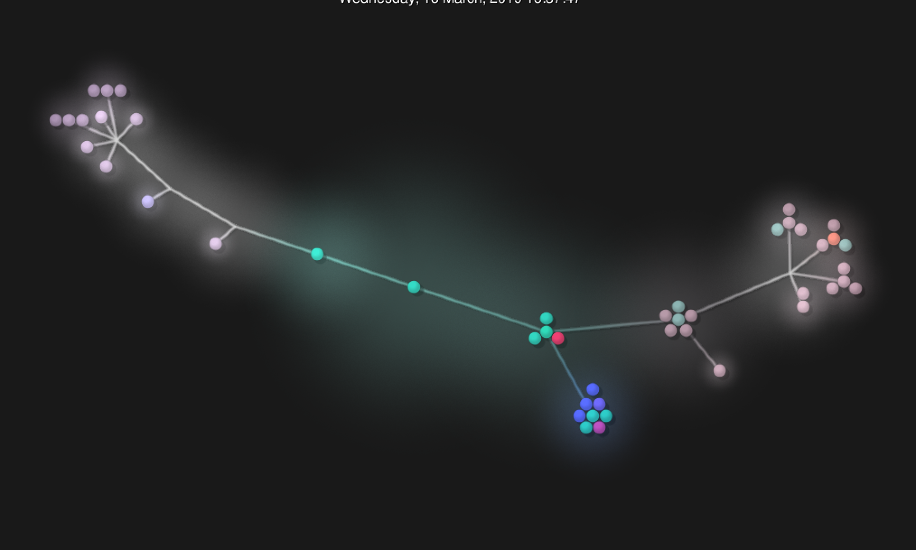
Rush hour A Restaurant Booking APp
Tom Kendrick - Michael Irwin - Slawomir Dyk - Katharina Simon
Final Project at Codeclan Edinburgh, Cohort E27, March 2019
Notes:
Show app first, then gource

Slide 2
roleplay
Notes:
Tom & kat

Slide 3
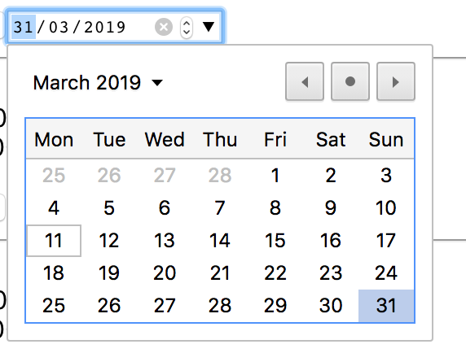
THE DATE Picker Headache
Notes:
Was solved by a single HTML5 – line - kat

Slide 4
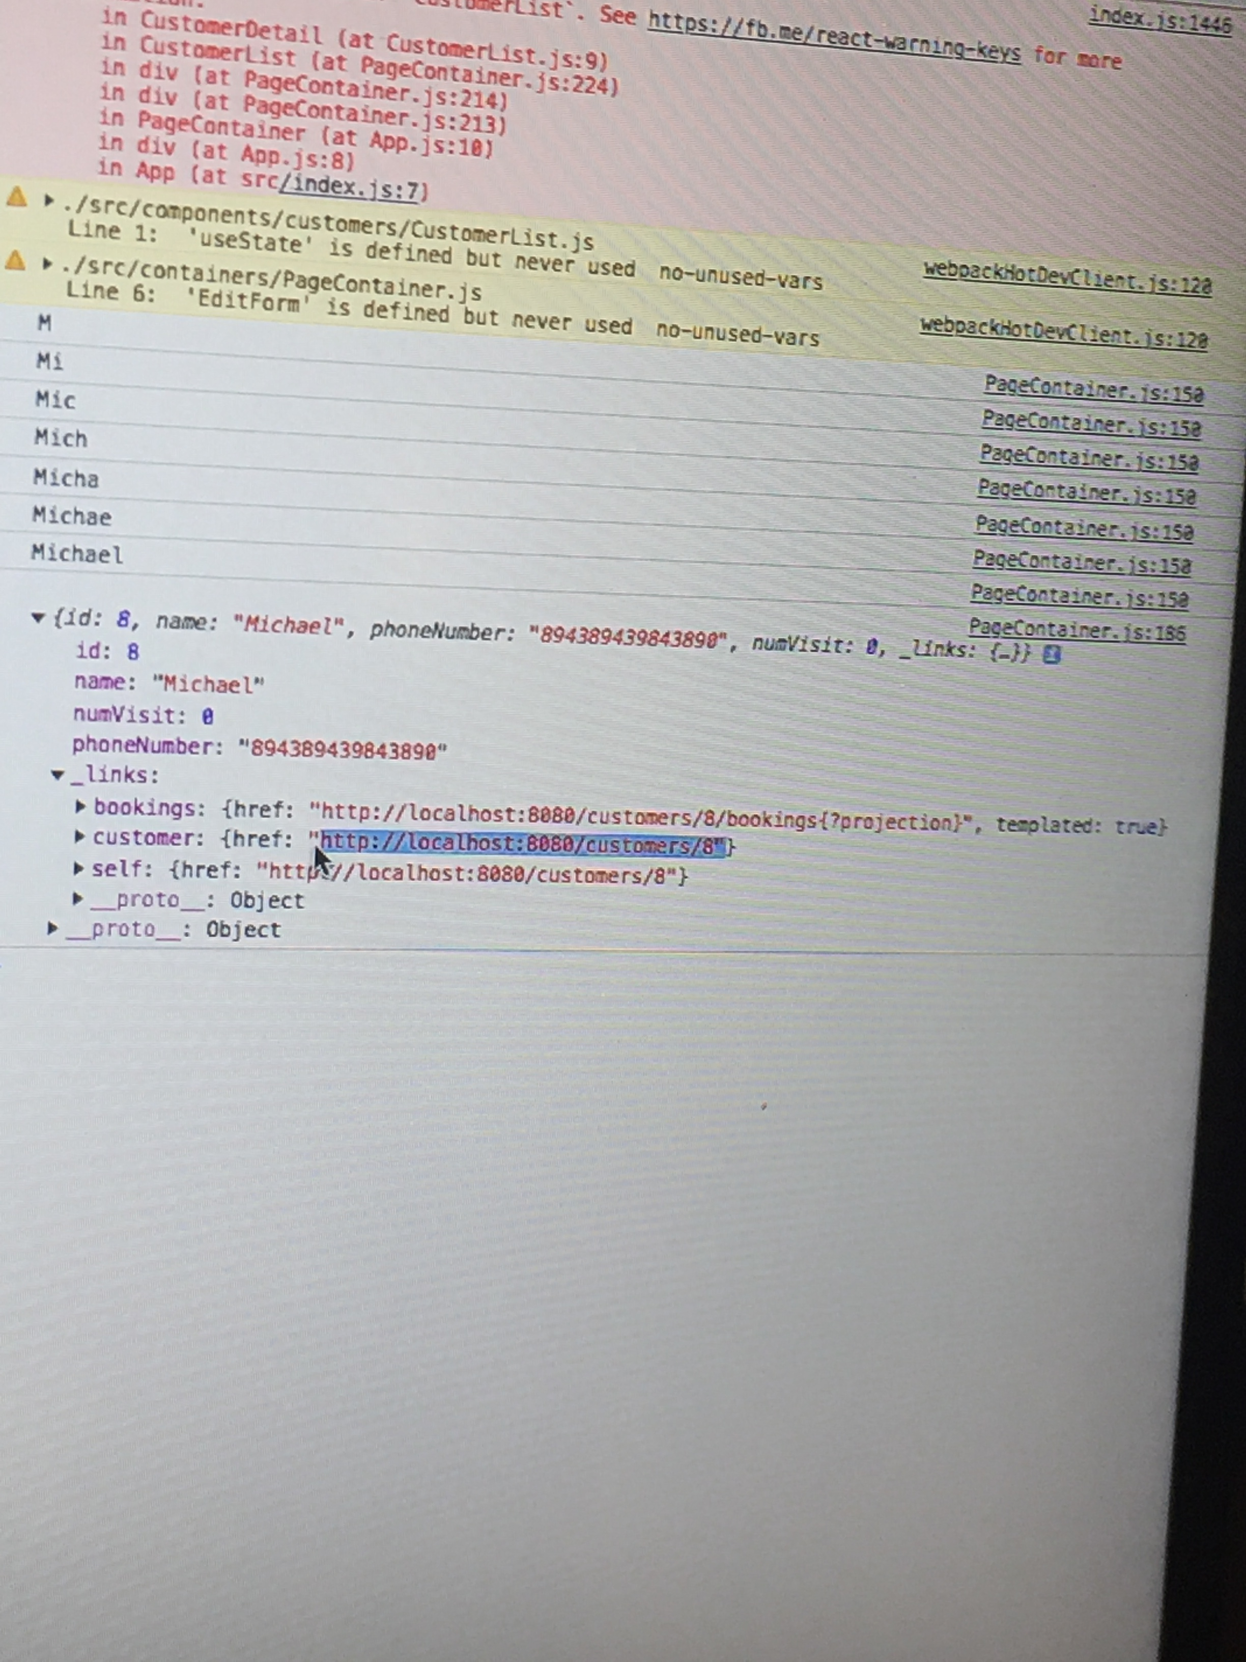
CRUD Headaches
Notes:
Michael

Slide 5
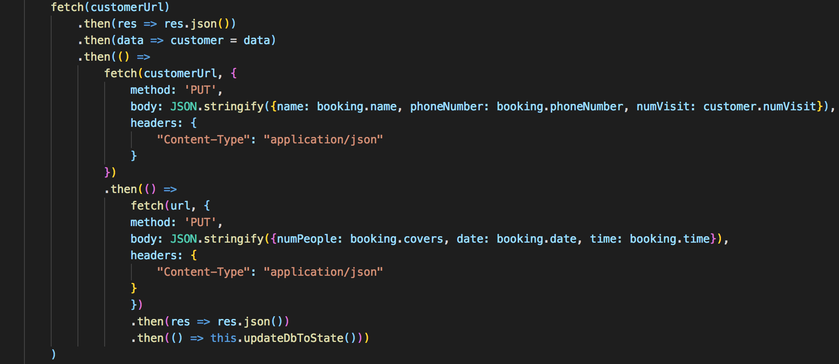
Component Refresh
Notes:
michael

Slide 6
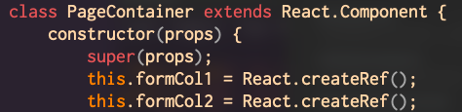
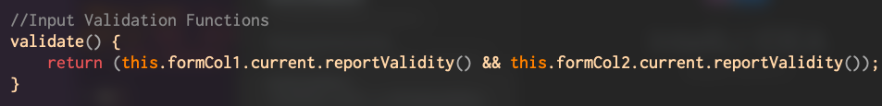
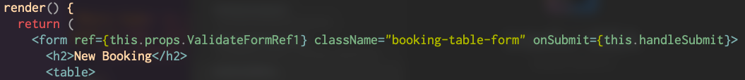
Input validation
Notes:
Tom

Slide 7
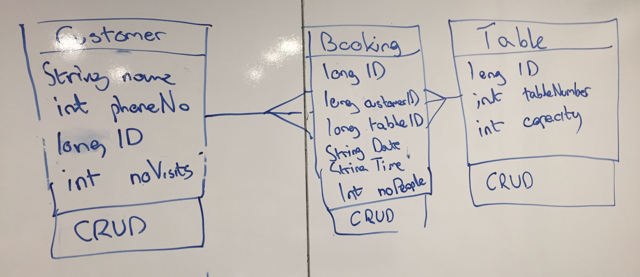
backend
Notes:
Slaw - stopping intellij

Slide 8
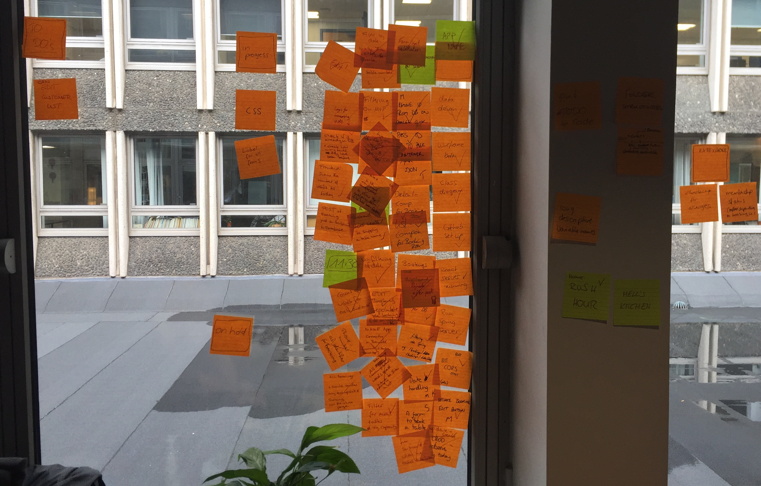
Extra Sticky sticky notes
Notes:
Tom

Slide 9
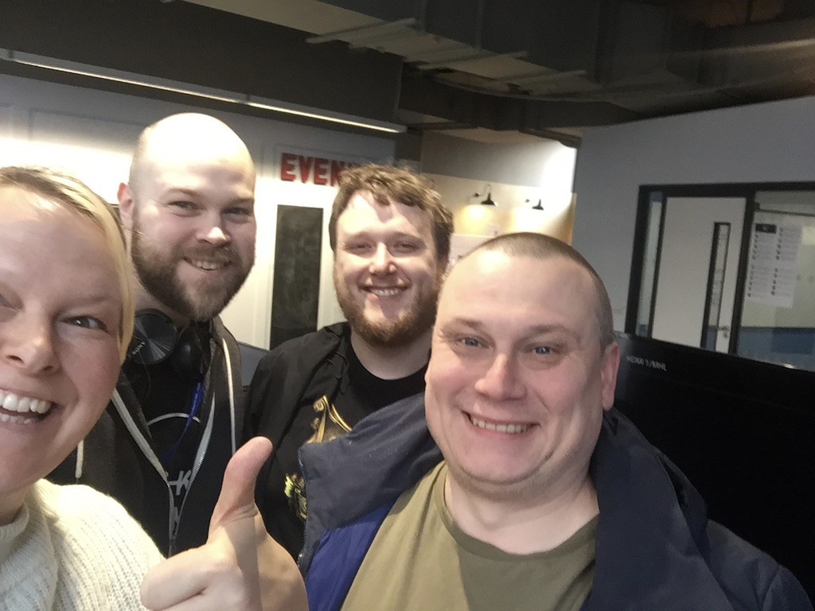
Thank you!

